Slide 1

SC2008/CZ3006/CE3005: Computer Networks
Recap of the previous lectures
Week 7’s Lecture 1: Network paradigms
Jun ZHAO
Assistant Professor
School of Computer Science and Engineering
(SCSE)
JunZhao@ntu.edu.sg
Office: N4-02C-111

Slide 2

Recap of the previous lectures
Wireless Local-Area Networks (WLAN)
Understand two WLAN architectures
802.11 (i.e., WiFi) Physical Layer
Understand different transmission schemes
AP
Infrastructure
Ad Hoc
802.11 Medium Access Control (MAC) Layer
Understand hidden and exposed terminals
Understand the carrier-sense multiple access with collision avoidance (CSMA/CA) protocol
Multi-Access Reservation Protocol (MARP)
Understand MARP and calculate its utilization

Slide 3


Recap of the previous lectures
To better understand network paradigms, you were asked to think about which one you would prefer:
Restaurant A:
Restaurant B:
requires reservations.
typically does not need reservations.

Slide 4
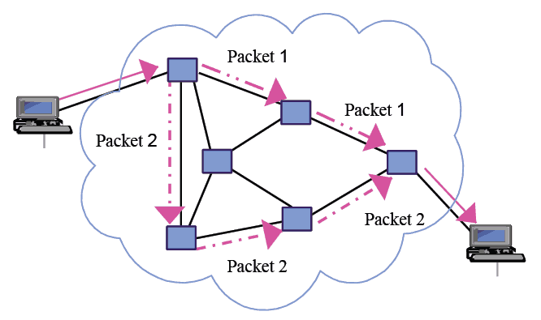
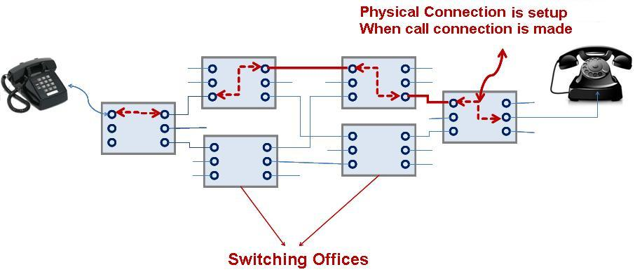
Recap of the previous lectures
We briefly mentioned two network paradigms (to be elaborated on today):
Circuit Switching
(e.g., the Telephone Network)
Restaurants requiring reservations
Packet Switching
(e.g., the current Internet)
Restaurants that typically do not need reservations

Slide 5
SC2008/CZ3006/CE3005: Syllabus for Weeks 1 to 7
Week​ | Date​ | Subject​
Week 1 | 9/Jan/2023​ | Introduction: Course Logistics and Internet History​
 | 11/Jan/2023​ | Layered Network Architecture​
Week 2 | 16/Jan/2023​ | Physical-layer Resilience
 | 18/Jan/2023​ | Data Link Layer: Flow Control​
Week 3 | 25/Jan/2023​ (no class on 23/Jan/2023, a holiday​) | Data Link Layer: Error Control​
Week 4 | 30/Jan/2023​ | Local Area Network: Introduction​
 | 01/Feb/2023​ | Local Area Network: Medium Access Control (MAC)​
Week 5 | 06/Feb/2023​ | Local Area Network: Ethernet​
 | 08/Feb/2023​ | Local Area Network: Ethernet Evolutions​
Week 6 | 13/Feb/2023​ | Wireless Local Area Network (WLAN): Overview and 802.11
 | 15/Feb/2023​ | First Part: WLAN’s Multi-Access Reservation Protocol (MARP); Second Part: A Brief Overview of Network Paradigms​
Week 7
 | 22/Feb/2023 | Network Paradigms​ (Continued) and Mobile Access Networks
20/Feb/2023 Network Paradigms​

Slide 6

Week 7’s Lecture 1
Network Paradigms
Circuit Switching
Packet Switching

Slide 7
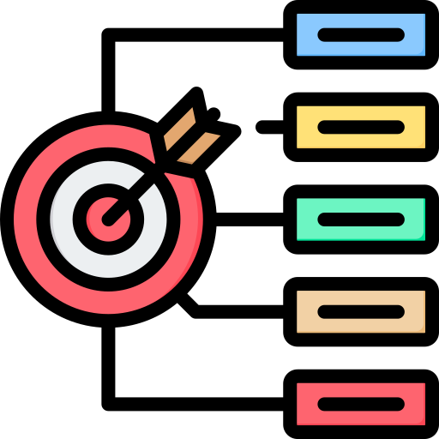
Learning objectives
Network paradigms
Understand how circuit switching works
Understand how packet switching works
Know that packet switching has two kinds: datagram and virtual-circuit
Identify the differences between circuit switching and packet switching

Slide 8
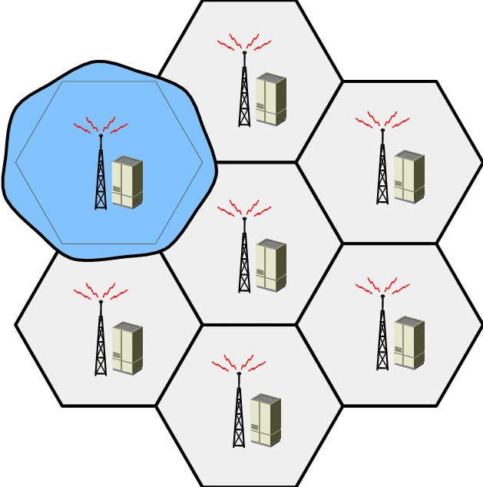
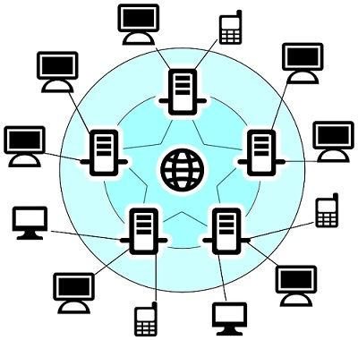
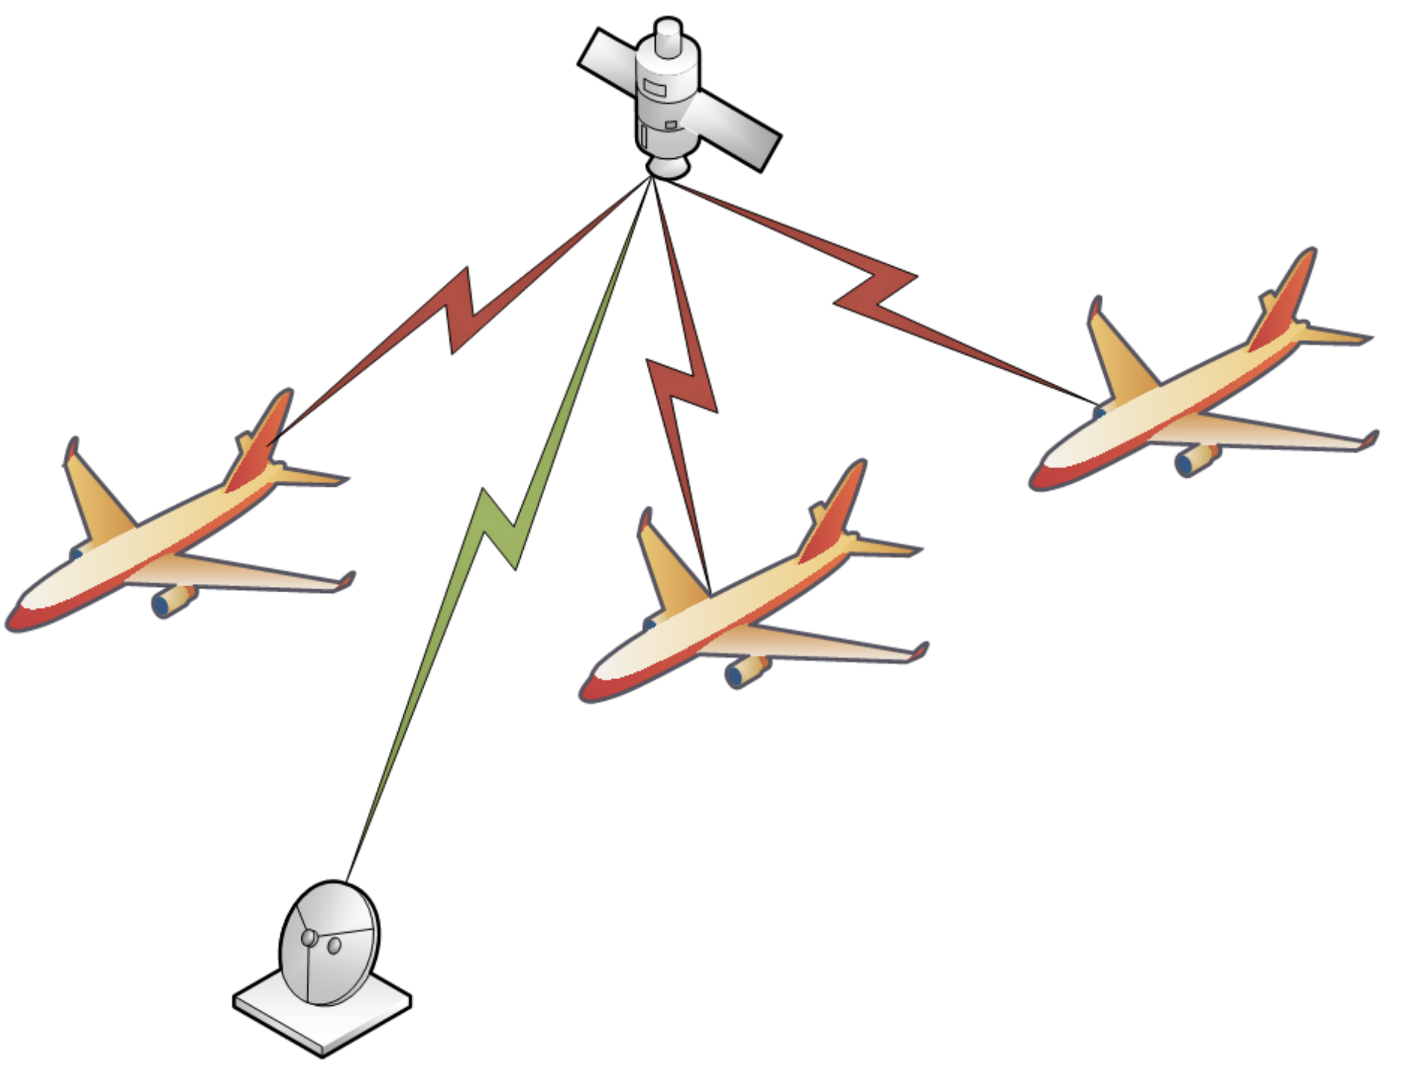
Significance of learning objectives
Switching technologies are fundamental knowledge points in computer networks.
Usage in real-world networks:
Circuit switching: Telephone networks, 2G/3G cellular networks (G means generation)
Datagram packet switching: The current Internet
Virtual-circuit packet switching: X.25 (in the aeronautical business)
They may be helpful for your job interview. ☺

Slide 9
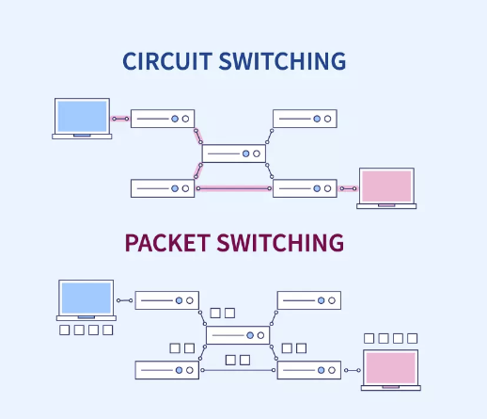
Contents
Circuit Switching Networks
The phrase
Basic operations
Examples
Advantages and disadvantages
From circuit switching to packet switching
Packet Switching Networks
Basic operations
Two kinds:
○ datagram and virtual-circuit
Advantages and disadvantages
Comparison between circuit switching and packet switching
Usage of circuit / packet switching in the real world

Slide 10
Circuit Switching Networks

Slide 11
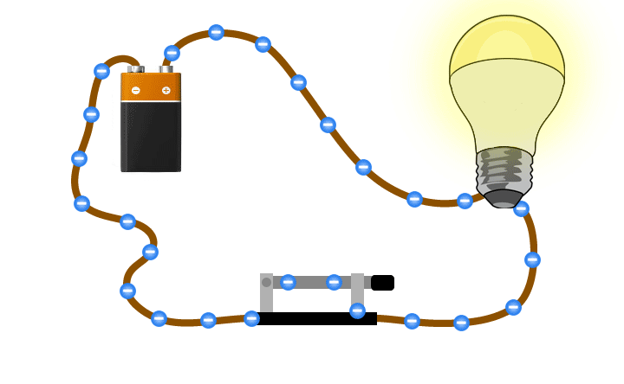
What is a circuit?
A path that electric current flows around.

Slide 12
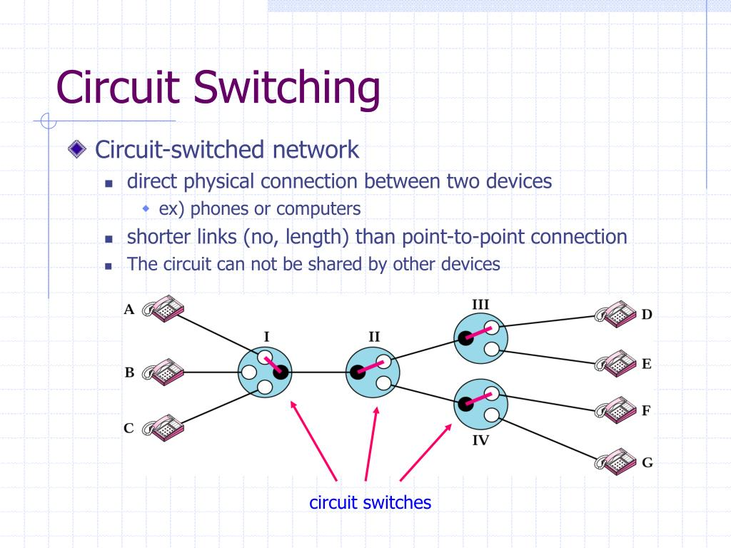
The phrase “circuit switching networks”: Why the word “circuit”?
In circuit switching, a dedicated path (by circuit) is established between two devices (e.g., telephones) before the devices can communicate.
The communication happens as if the devices were physically connected by an electrical circuit.

Slide 13
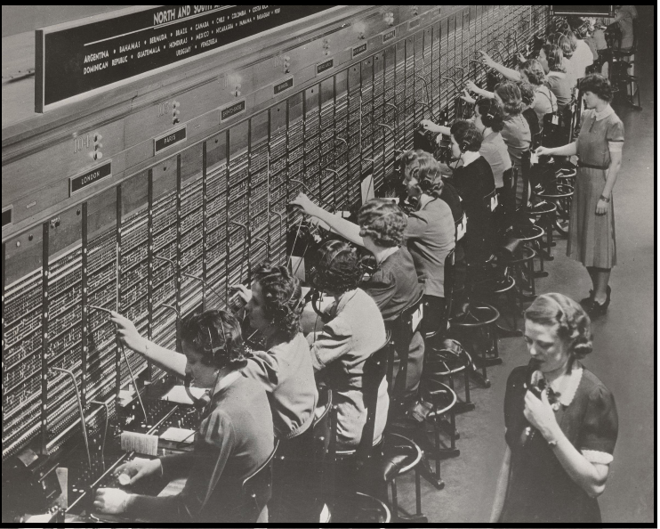
The phrase “circuit switching networks”: Why the word “switching”?
To avoid having a permanent physical link between any two devices, the network uses switches.
The Public Switched Telephone Network (PSTN)
The switching was done by
human operators before 1890s.

Slide 14

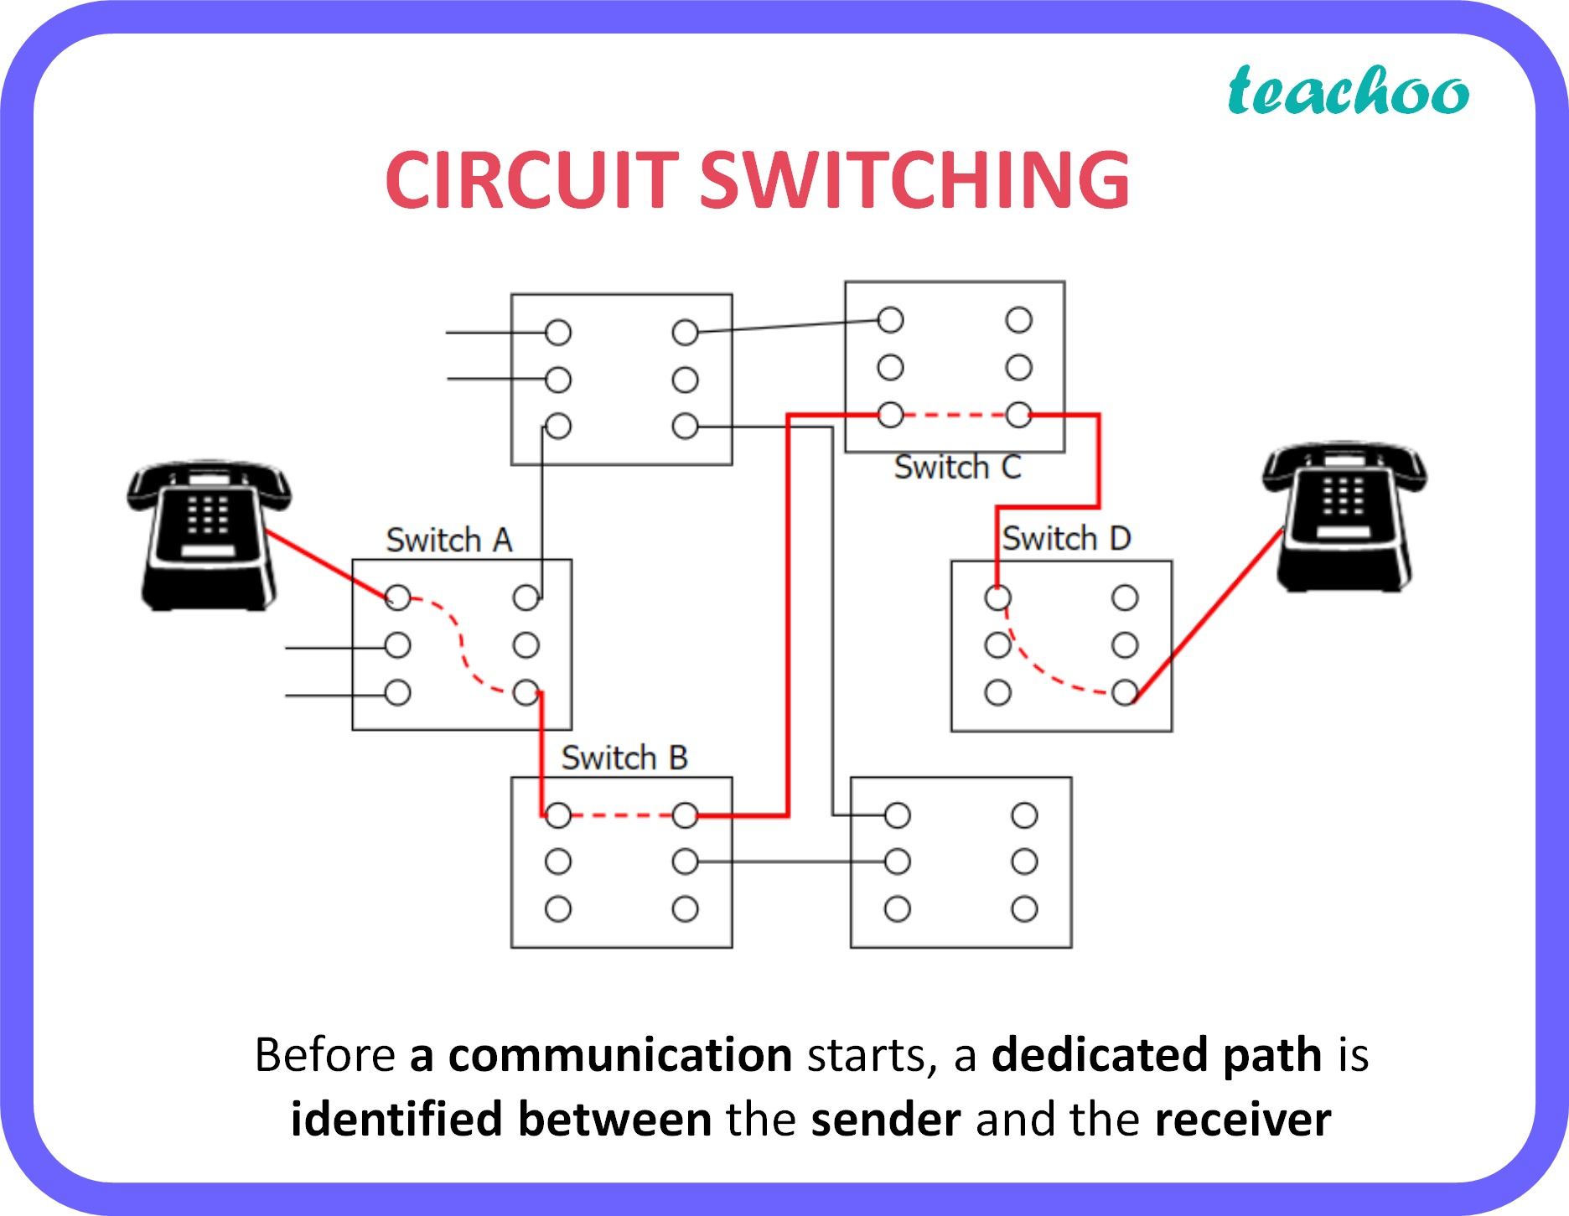
Basic operations in circuit switching
Three phases:
Circuit establishment
Identify a dedicated path link by link
Circuit disconnect
No overhead bits for addressing/routing are required
Ordered transfer of data
Deallocate the dedicated resource

Slide 15
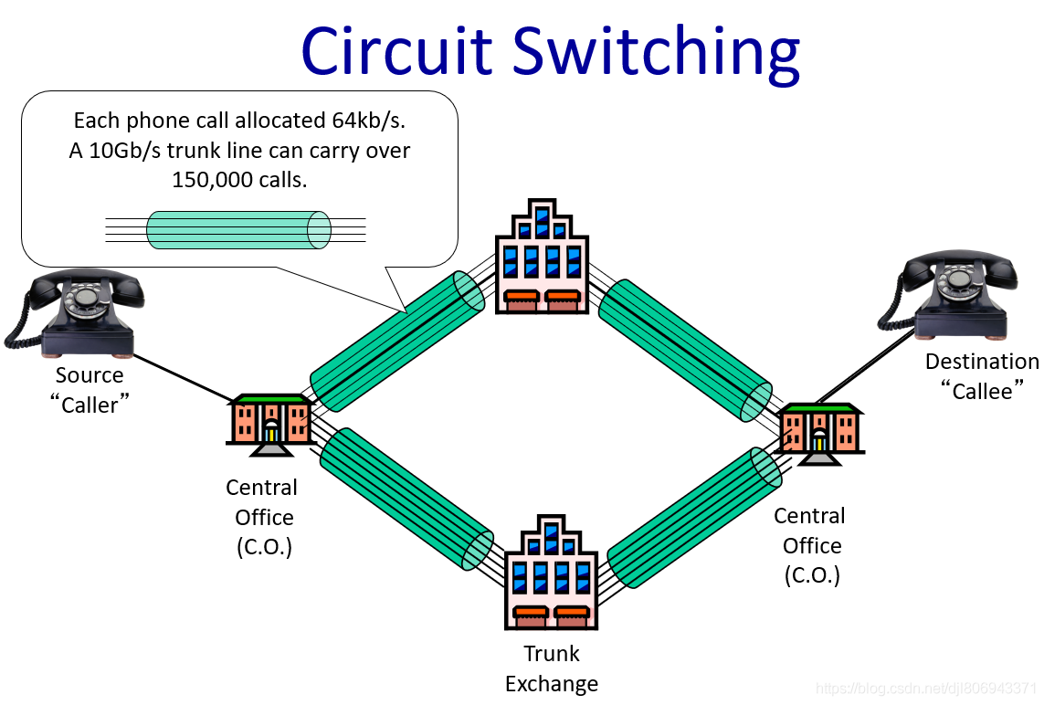
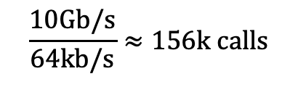
A concrete example: How many connections can be supported?
Each phone call is allocated 64kb/s. A 10 Gb/s trunk line can carry over
$$\frac{10Gb/s}{64kb/s}≈156k calls$$
how many calls?
about 156k calls.

Slide 16
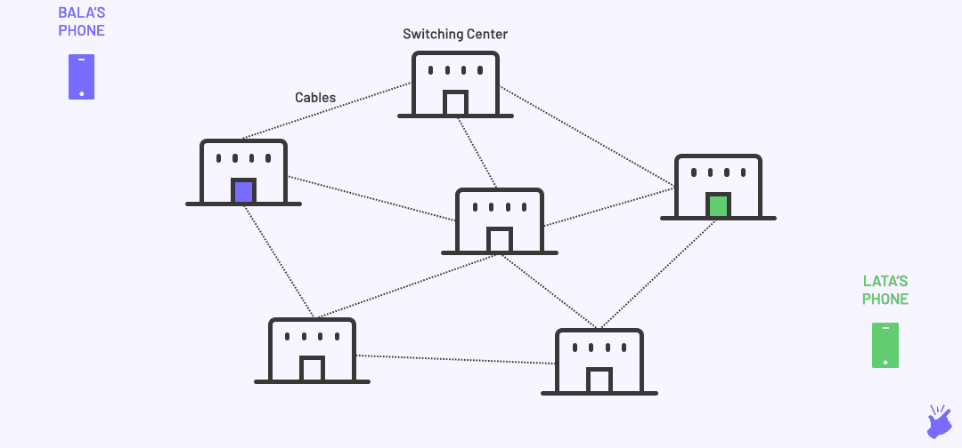
Another example: Circuit switching for mobile phone calls
The circuit includes:
The wireless link between Alice and Base Station A
The physical link between Base Station A and Base Station B
The wireless link between Base Station B and Bob
Alice
Base Station B
Base Station A
Bob

Slide 17



Summary of circuit switching
Advantages | Disadvantages
Continuous data transfer without the overhead associated with packets The connection remains reserved and protected from competing users | Resources occupied by particular connections Scalability limitation For some of the time, the connection may have no data Data rate is limited

Slide 18

Why circuit switching is not suitable for data communication over the Internet?
Billions of devices are connected to the Internet now.
If circuit switching is used, the resources to maintain the circuit path will be more than the network can bear.

Slide 19
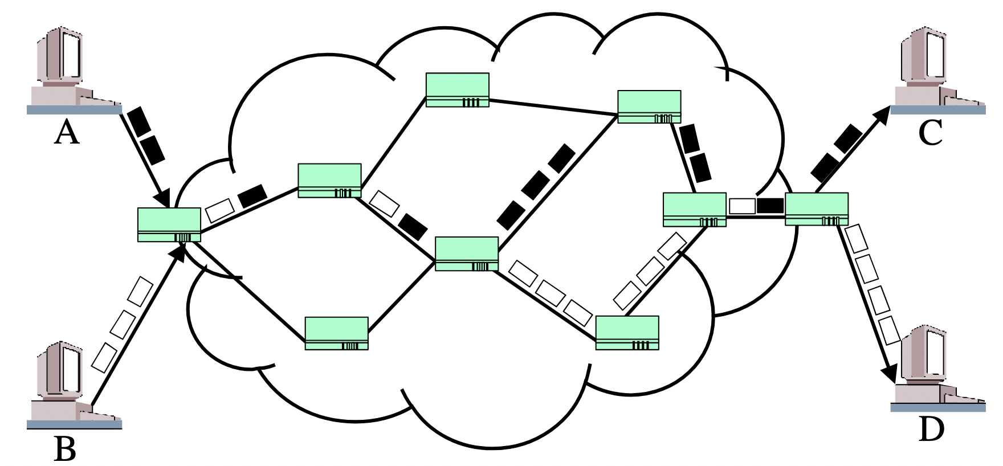
From circuit switching to packet switching
Circuit switching has been mostly for telephone networks since 1878. It is not suitable for Internet data communication. | For data communication on the Internet and its precursors, packet switching was invented in 1960s.
Circuit Switching
Packet Switching

Slide 20
Packet Switching Networks

Slide 21
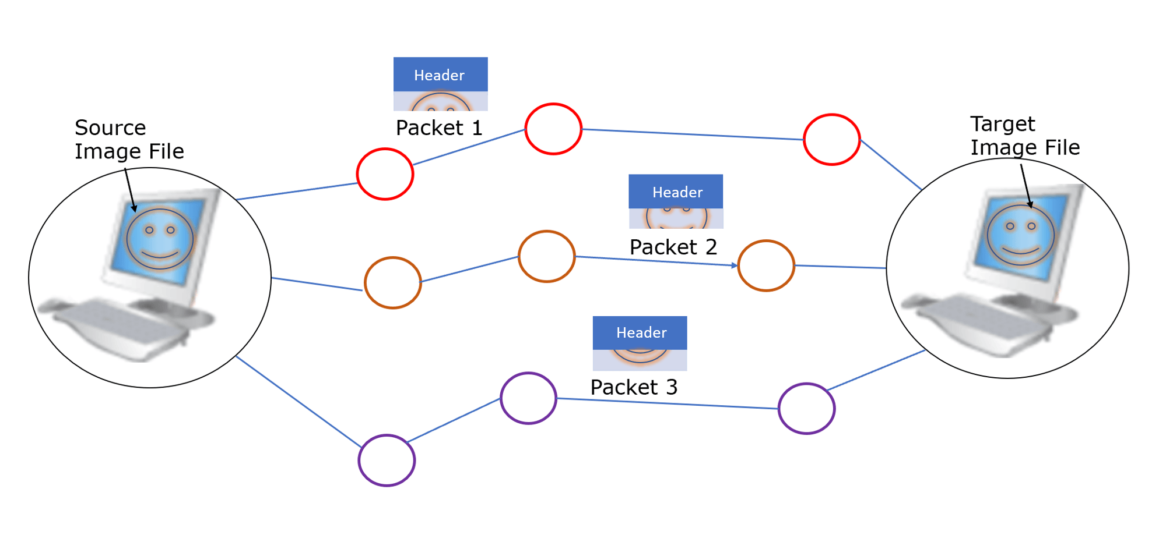
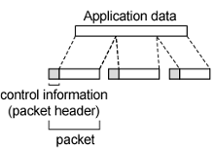
Basic operations in packet switching
Data are transmitted in short packets
Longer messages are split into a series of packets
A packet is typically at the order of 1000 bytes
Each packet contains a portion of user data plus some control info
Control info contains at least routing (addressing) info

Slide 22
Two kinds of packet switching
Packets are sent out to the network sequentially, one at a time.
How does the network handle the stream of packets and deliver them to the destination?
Two Kinds: Datagram, Virtual-Circuit

Slide 23
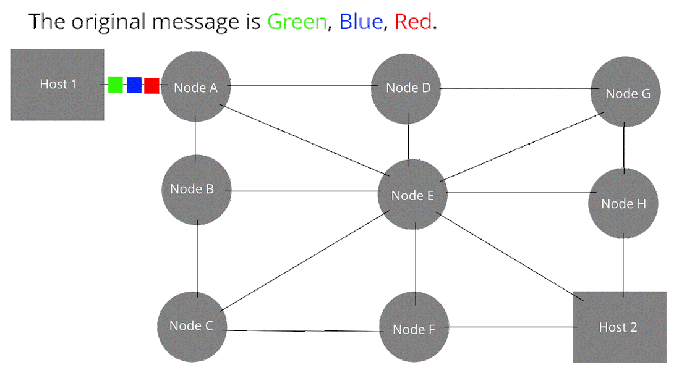
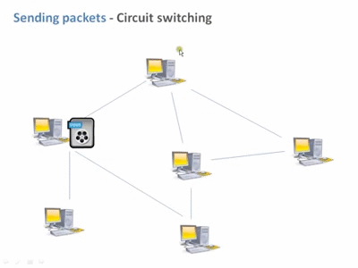
Packet switching: What happens in the network?
Store and Forward: On each switching node, packets are received, stored briefly (buffered) and passed on to the next node.
For datagram packet switching:
For virtual-circuit packet switching:

Slide 24
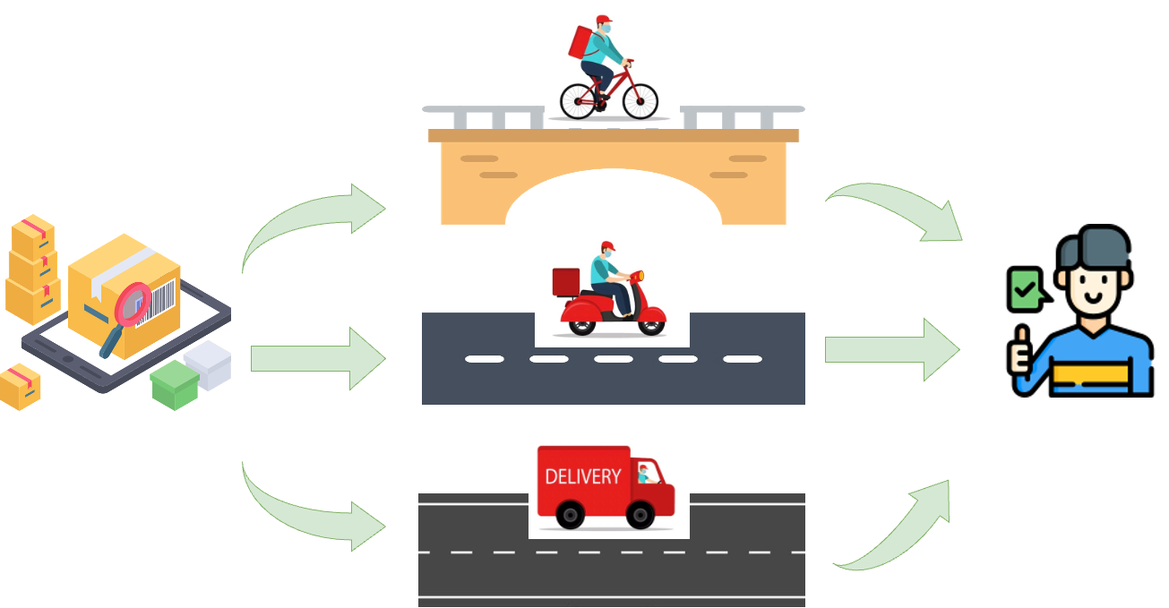
An analogy of datagram packet switching
Package delivery systems, where packages may travel on different paths.

Slide 25
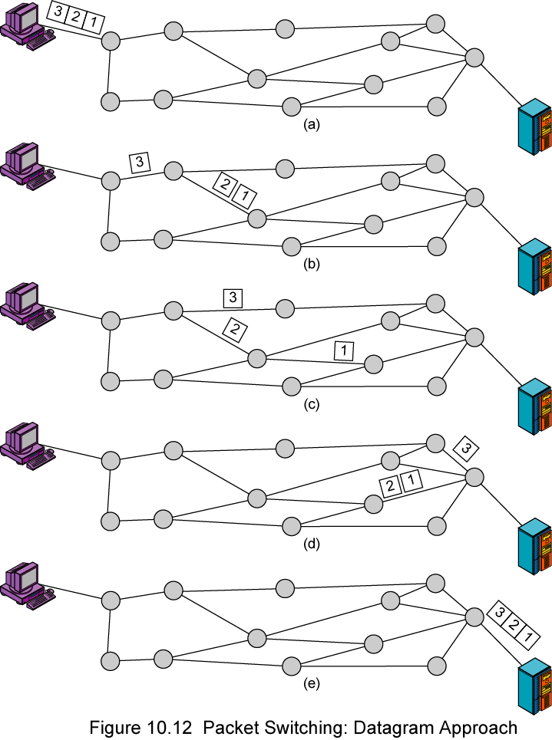
Datagram packet switching
Each packet includes the sequence number and the destination address.
Each packet is treated independently.
Packets may arrive out of sequence.
Packets are called datagrams.

Slide 26
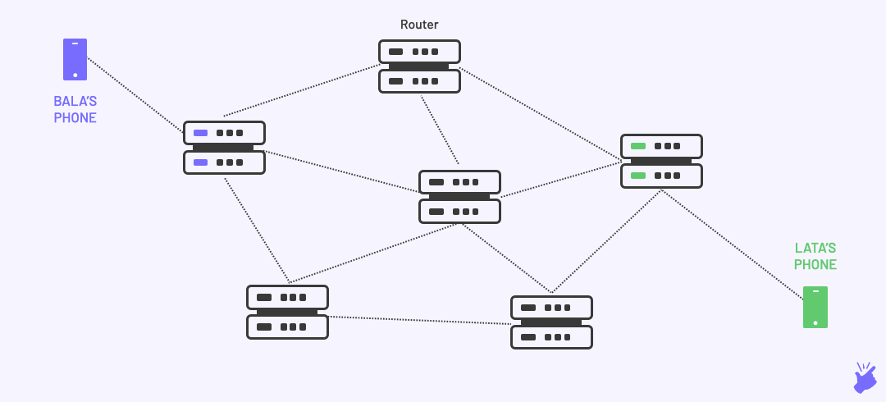
Datagram packet switching
The message “Hello” that Alice wants to send to Bob is broken into packets.
The packets take different paths to the destination Bob, and Bob needs to sort them in the correct order.
Alice
Bob

Slide 27
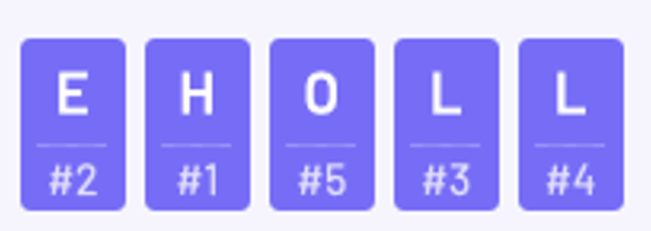
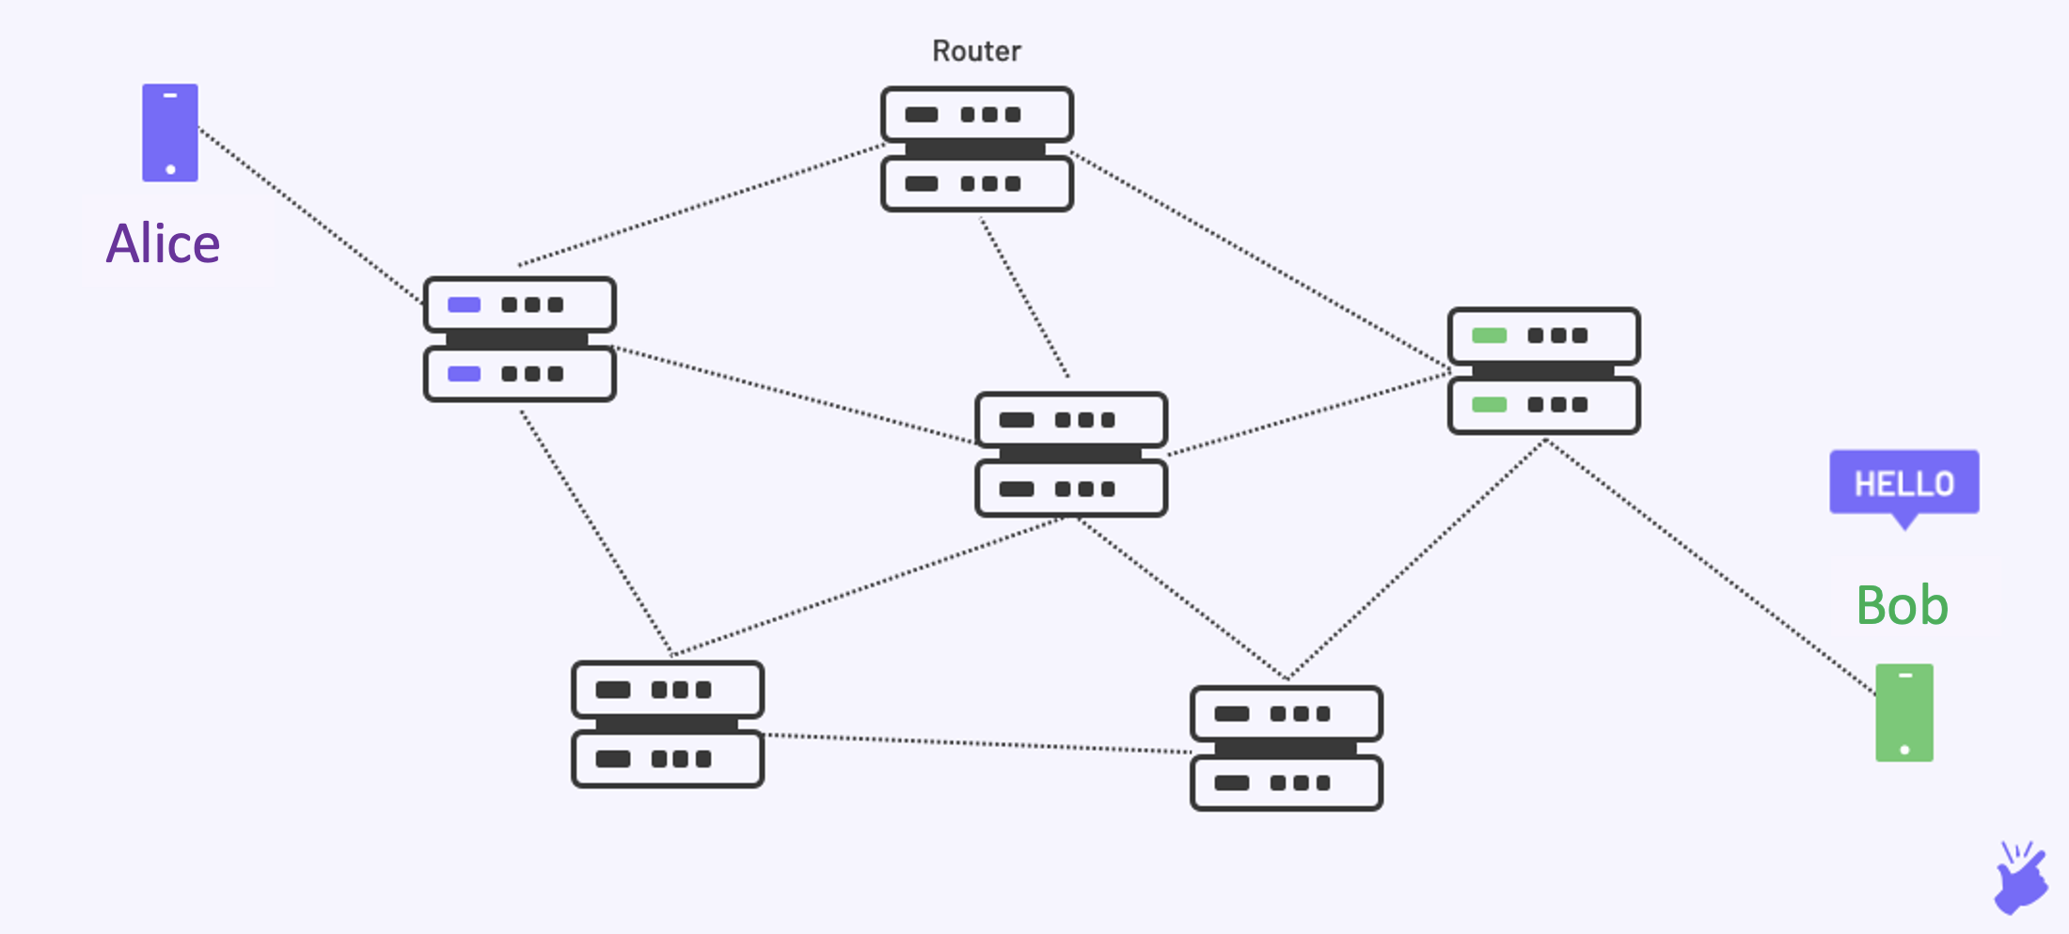

Datagram packet switching
The message “Hello” that Alice wants to send to Bob is broken into packets.
The packets take different paths to the destination Bob, and Bob needs to sort them in the correct order.
Sort packets by
sequence numbers

Slide 28

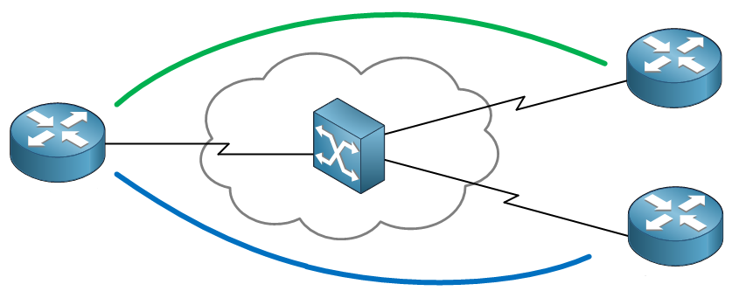




Virtual-circuit packet switching
In virtual circuit, a path is established before any packets are sent.
All packets follow the same path that was established.
Virtual Circuit

Slide 29
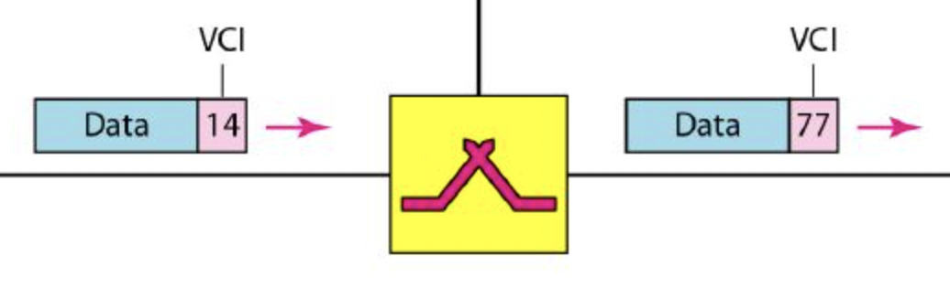
Virtual-circuit packet switching
Each packet contains a Virtual Circuit Identifier (VCI) instead of the destination address.
Each node on the pre-established path knows where to forward such packets.
Note that there are no dedicated resources reserved for the path. Resources are shared by all communications.
Virtual Circuit

Slide 30
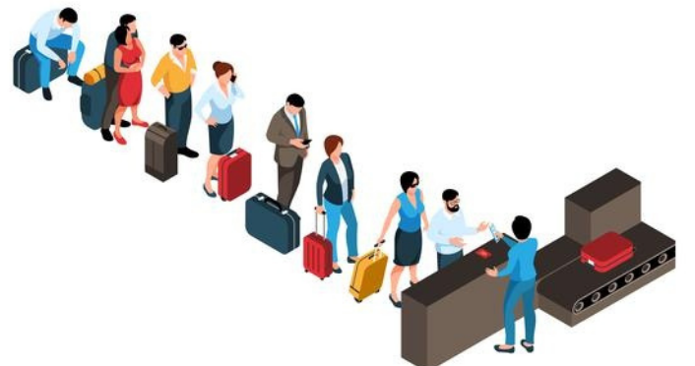

Summary of packet switching
Advantages | Disadvantages
Efficient Node-to-node links can be dynamically shared by many packets. Packets are queued up and transmitted as fast as possible. | The queue of packets may cause a longer delay
Even with heavy traffic, packets are still accepted in packet-switching networks. | Packets may get lost and need to be retransmitted without a stable connection

Slide 31

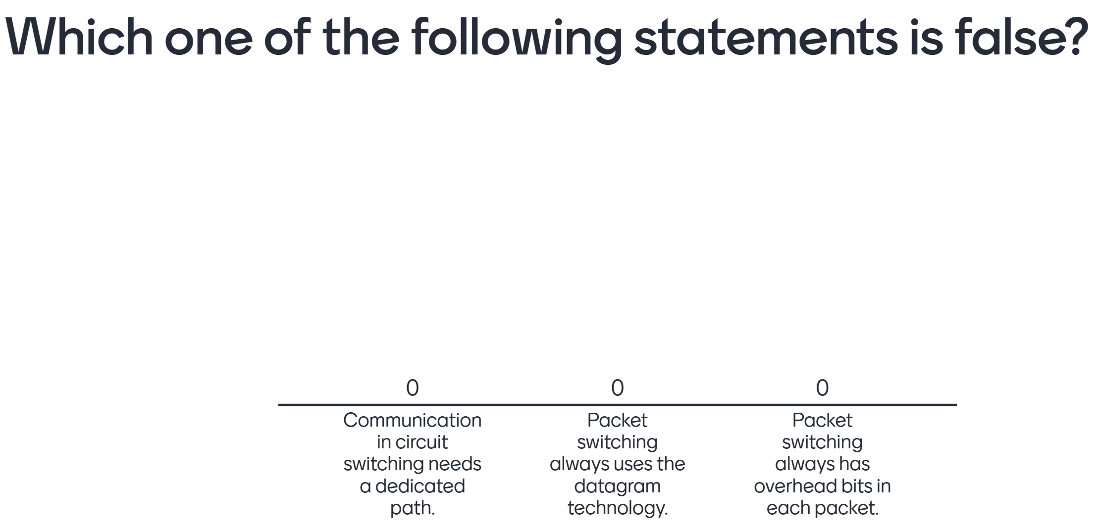
A quiz
You can visit www.menti.com and enter code 5619 9500.

Slide 32

Compare circuit switching and packet switching
Circuit switching | Packet switching
Set up a dedicated path | Datagram: doesn’t fix a path before data transfer Virtual-circuit: fix a path before data transfer, but no dedicated resources on the links of the path.
Ordered transfer of data | Transmission of individual packets
Overload may block connection setup No queuing delay for established connections | Overload increases packet delay
No overhead bits after connection setup | Overhead bits in each packet

Slide 33


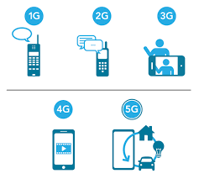
Usage of circuit switching and packet switching in the real world
Telephone networks (e.g., landlines) that support voice calls only: circuit switching
Data communication on the current Internet: packet switching
Cellular networks — A topic for next lecture:
(G means generation.)
1G (voice only):
2G and 3G (voice and limited data service):
4G and 5G:
circuit switching
circuit switching
use packet switching and transmit
voice as data of higher priority over the Internet

Slide 34

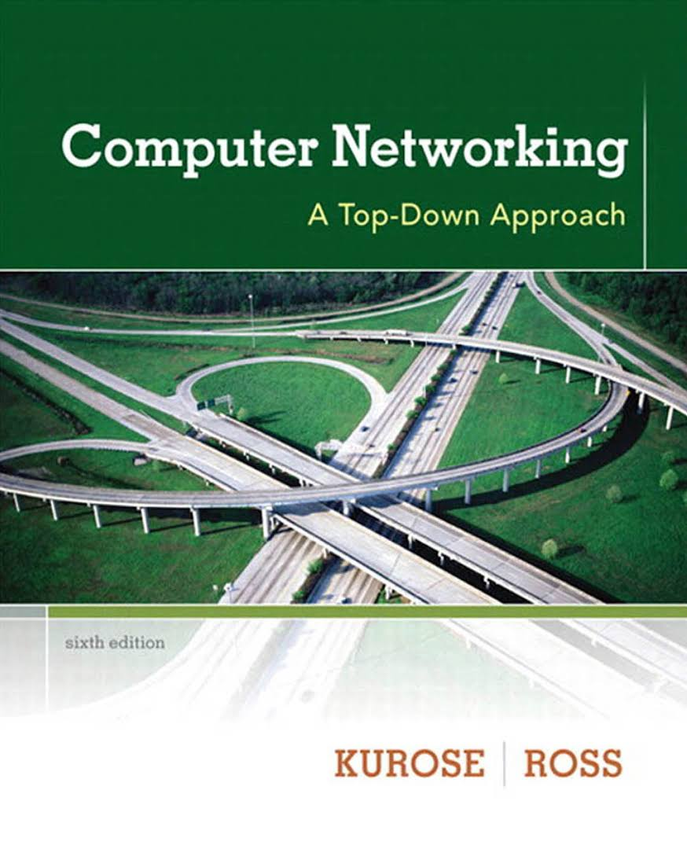
Additional materials
The book “Computer Networking: A Top-Down Approach” by James Kurose and Keith Ross:
Circuit Switching: Page 27 – Page 31 (6th Edition)
Packet Switching: Page 22 – Page 27 (6th Edition)
You can also watch online videos:
Switching techniques: https://www.youtube.com/watch?v=-HlJ4psu5aU
Circuit switching versus packet switching :
https://www.youtube.com/watch?v=oUN-s6aFMTk

Slide 35
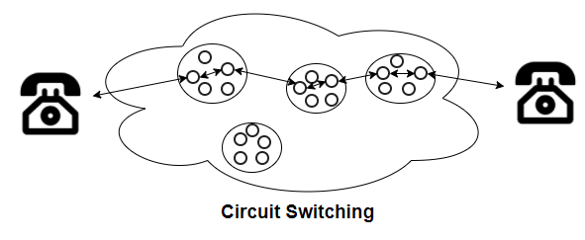
Main points of this class
Circuit switching needs to establish a dedicated path between two devices before they can communicate.
Packet switching sends data as individual packets.
In datagram packet switching, two devices do not need to pre-establish a path before data transfer.
In virtual-circuit packet switching, two devices fix a path before data transfer, but no dedicated resources are allocated on the links of the path.
You can also watch online videos:
Switching techniques: https://www.youtube.com/watch?v=-HlJ4psu5aU
Circuit switching versus packet switching :
https://www.youtube.com/watch?v=oUN-s6aFMTk

Slide 36


Jun ZHAO
JunZhao@ntu.edu.sg
Office: N4-02C-111
Weekly consultation time:
Thursday 2:30pm – 5:30pm
in NS4 Tutorial Room (TR) 17

